Slide 1
Geospatial And channel analysis
Using python

Slide 2
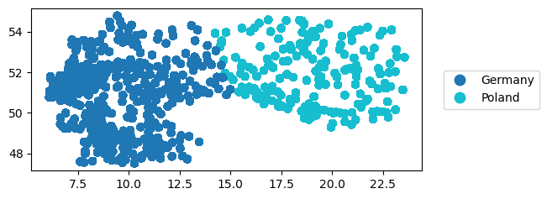
Geospatial analysis
* Here’s a plot showing the geopandas dataframe
* More concentration of sales entries in Germany than in Poland

Slide 3
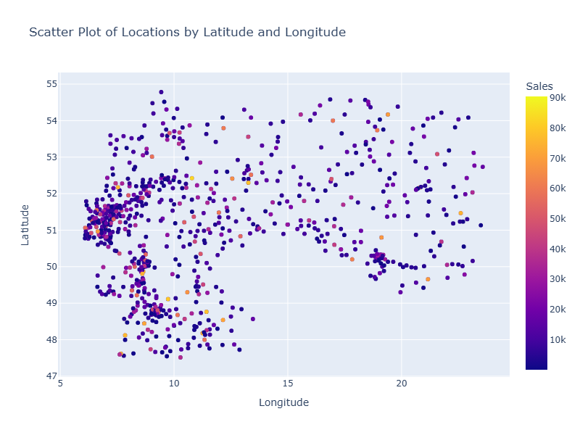
GEOSPATIAL ANALYSIS
* Most sales are between 0 to 10k
*There’s a significantl number of high sales in Germany
*

Slide 4
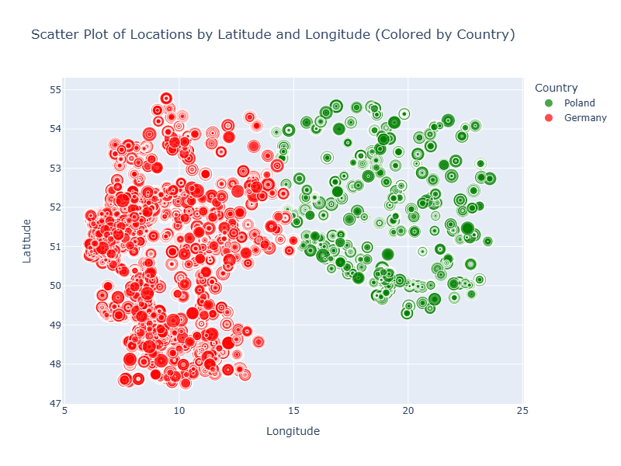
Geospatial analysis
*The point sizes represent the size of sales
*There’s a much larger concentration of huge points in the Germany area

Slide 5
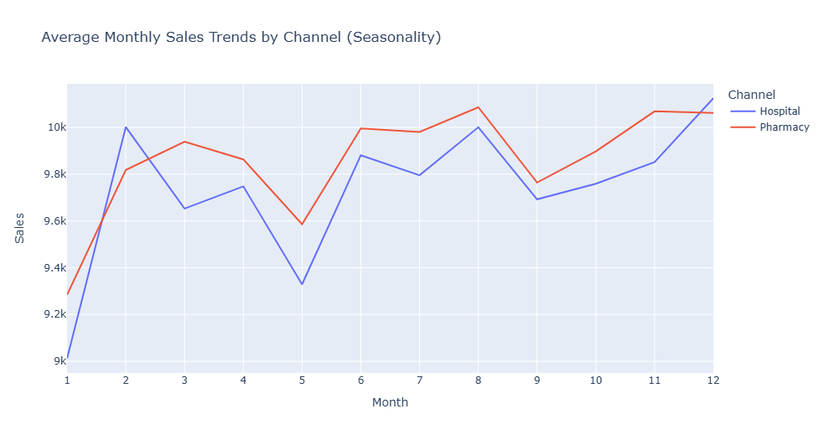
Channel analysis
*Monthly sales range from 9k to 10k on the average (without outliers)
*There are sales peak periods in February, June, August and December
*Pharmacy channel shows slightly more average sales for most months

Slide 6
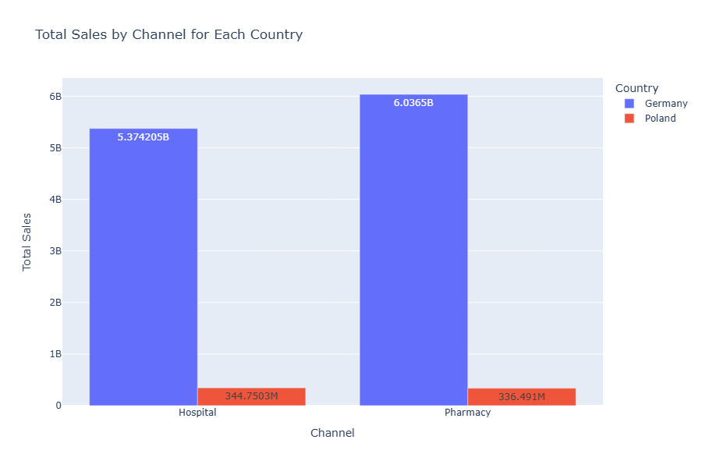
Channel analysis
*The Pharmacy channel is doing significantly more sales than the Hospital channel in Germany, while the Hospital has more sales in Poland

Slide 7
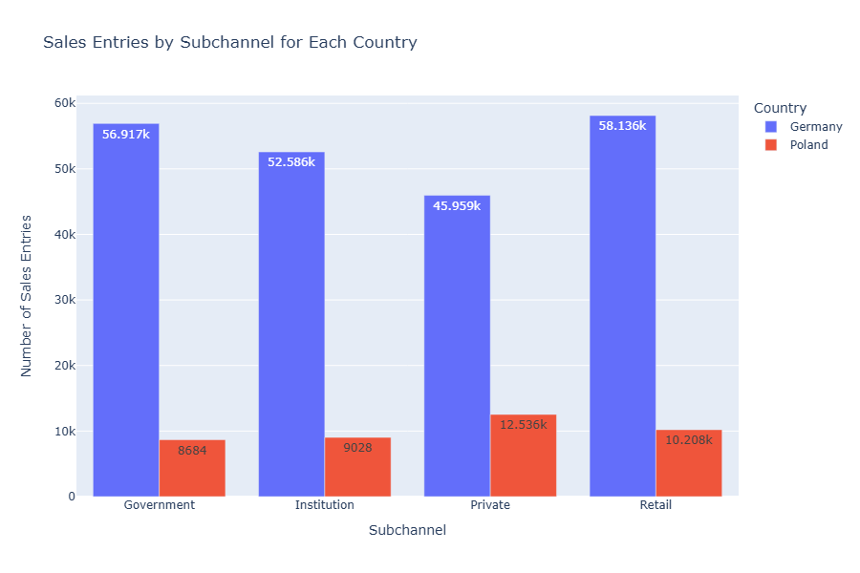
Channel analysis
*In Germany, the Retail subchannel of the Pharmacy channel is the most profitable subchannel
*In Poland, the Private subchannel of Hospital channel is the most profitable
*The highest sales income by sub channel is 58,136 Euros while the lowest is 8684 Euros

